Slide 1
Lecture 8
Consequences of Network Models of Cities
8.1 Predictive Consequences of Urban Scaling Theory
IUS 3.3
©Luís M. A. Bettencourt 2023 @BettencourtLuis bettencourt@uchicago.edu

Slide 2
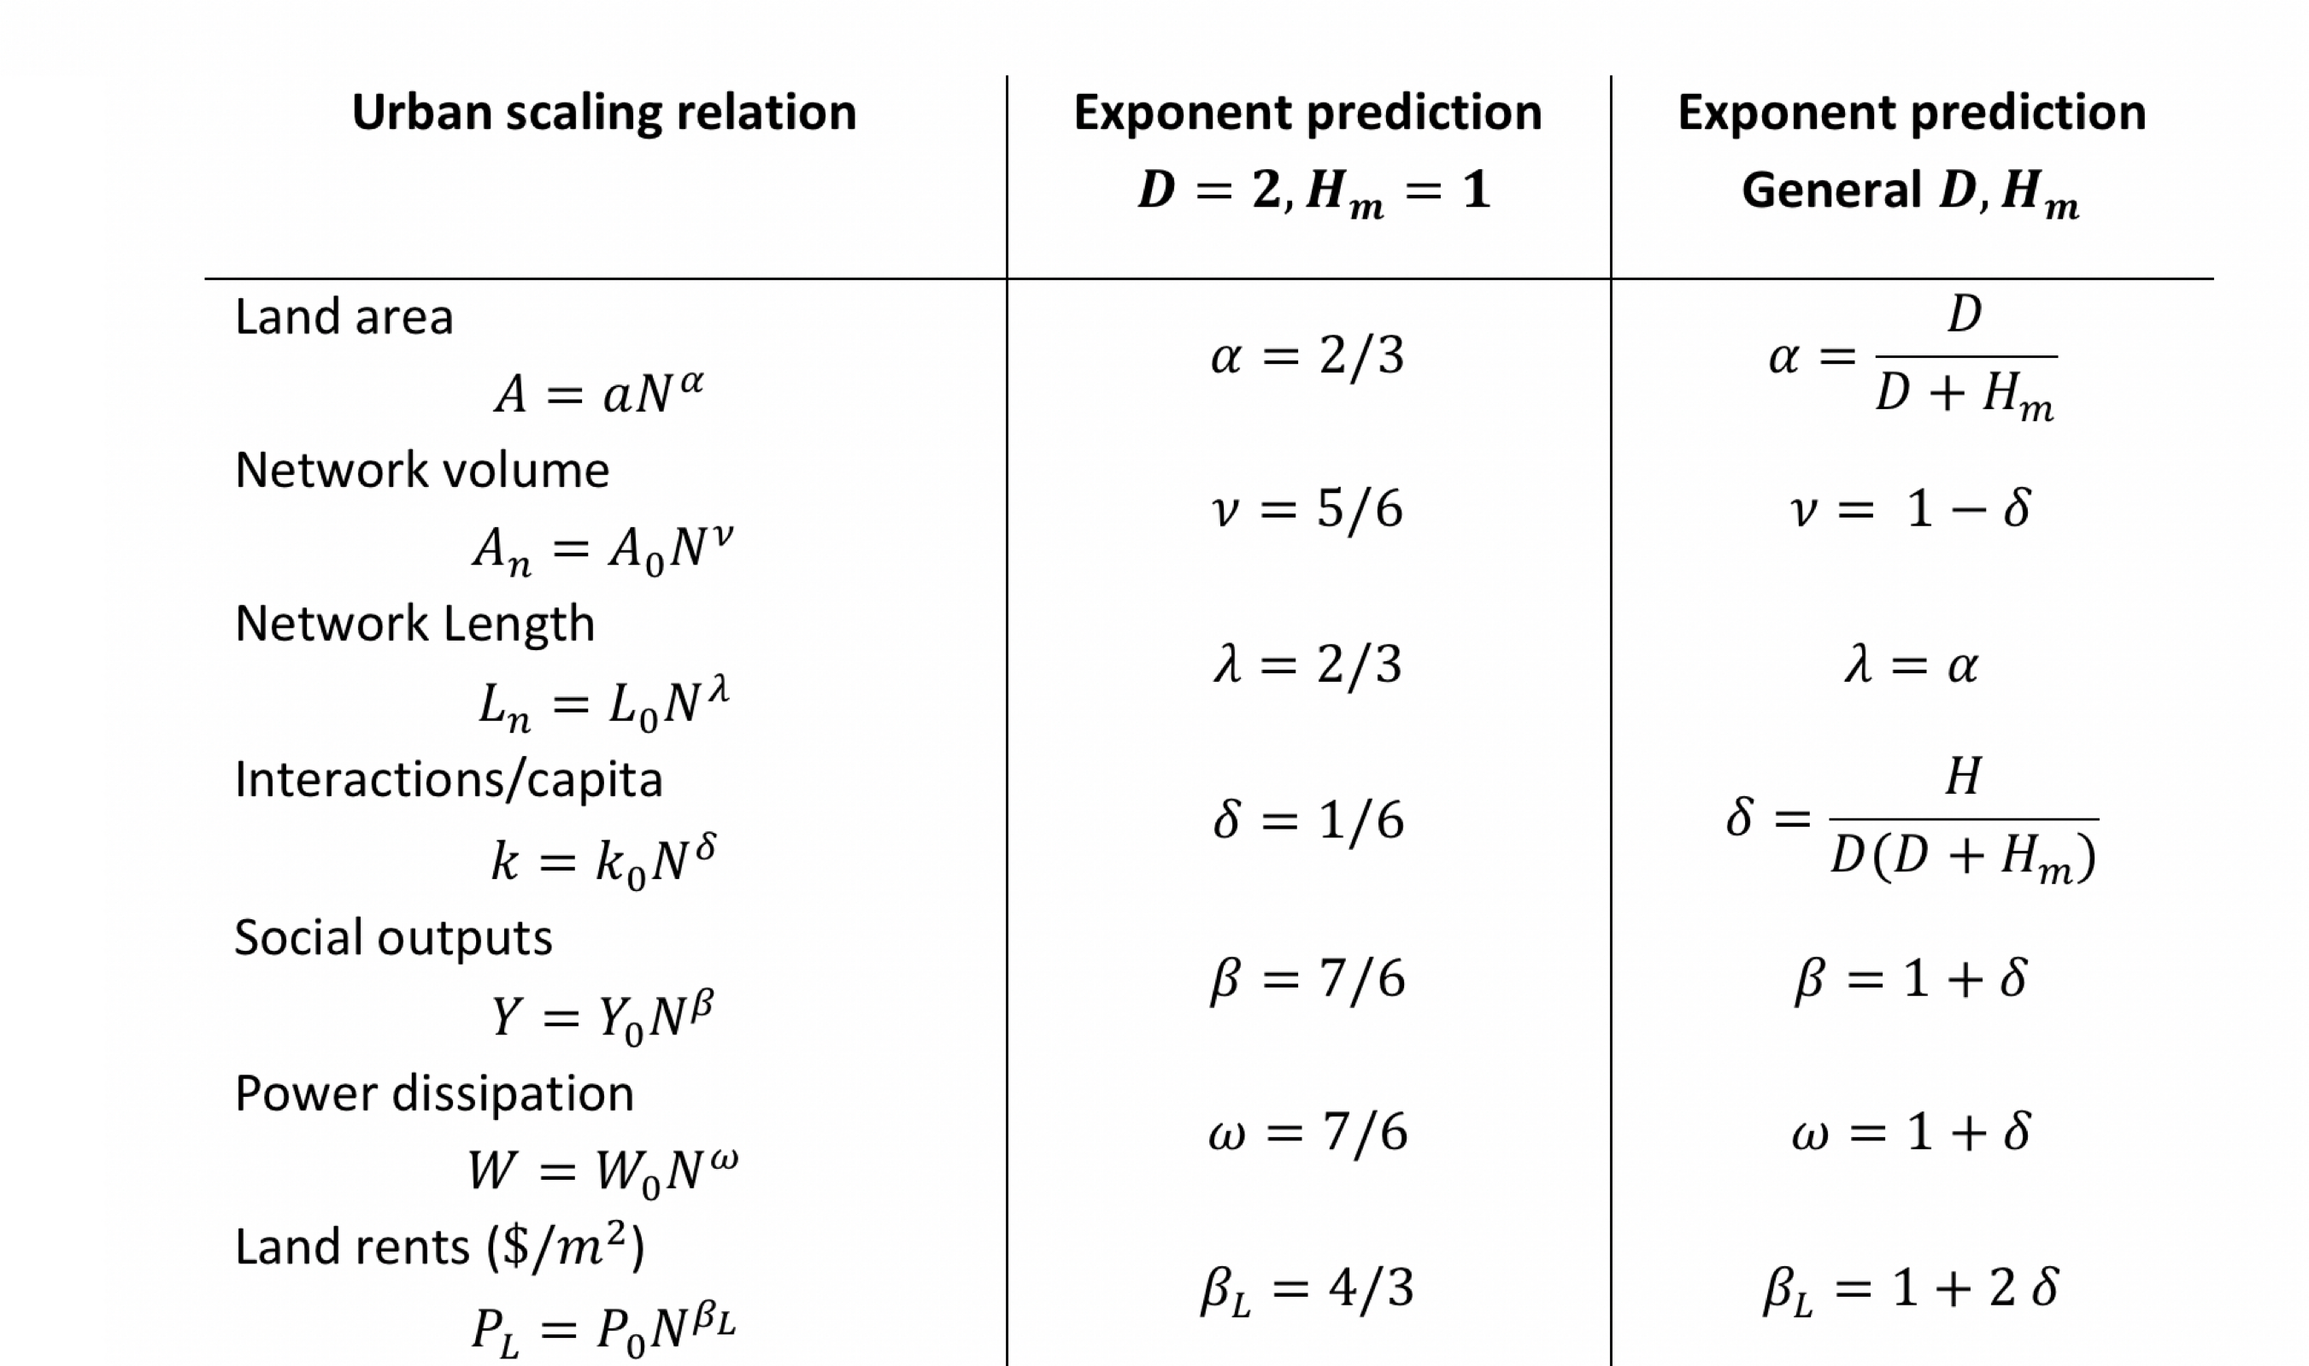
Many quantitative predictions + general consequences
Summary of Urban Scaling relations and exponent predictions for various important quantities. Note that agglomeration effects vanish when $H_{m}→0$ because then people remain spatially separated social networks fail to emerge (we will look at internet quantities later).
Notes:
This summarizes the results for the scaling exponents from urban scaling theory, from the previous module.

Slide 3
Besides predictions for scaling of all these quantities…
There are a number of very interesting combinations and ratios:
- The ratio of built volume to total area of cities
- The depth of social networks in cities vs the size of the entire population
- The “price” of land (land rents): or the rate of money exchanged per land area
- The ratio of land rents and incomes and building heights
Notes:
There are many other interesting predictions that follow from urban scaling theory.

Slide 4
Landscapes of Infrastructure
$$A_{n}/A∼N^{δ}$$
Greater infrastructure network volume per unit area with city size, especially in city centers

Slide 5

Master/Trunk infrastructure gets enormous

Slide 6

infrastructure networks must push into the third dimension
credit: MacLean

Slide 7
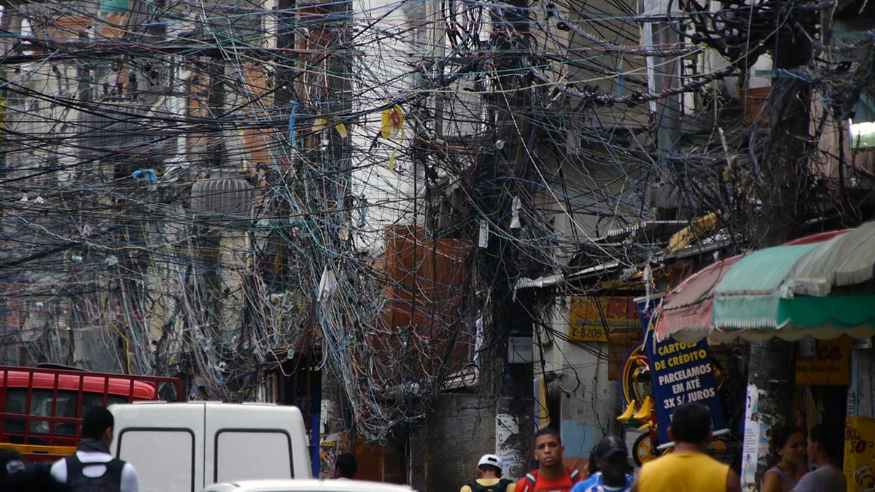
infrastructure networks take over many urban spaces
credit: Robert Stone

Slide 8
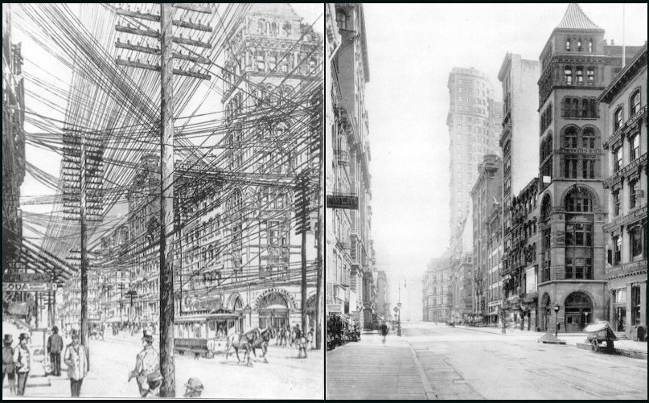
NYC before and after ice storm and burying of electrical cables
1890s New York City
credit: www.loper-os.org
And must go into the third dimension, above or below ground to leave space for people

Slide 9
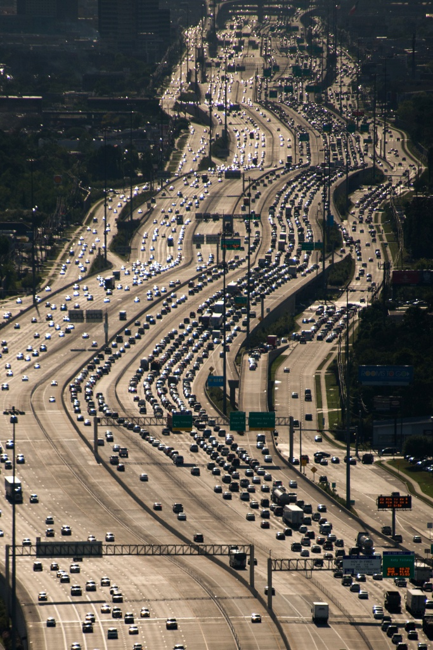
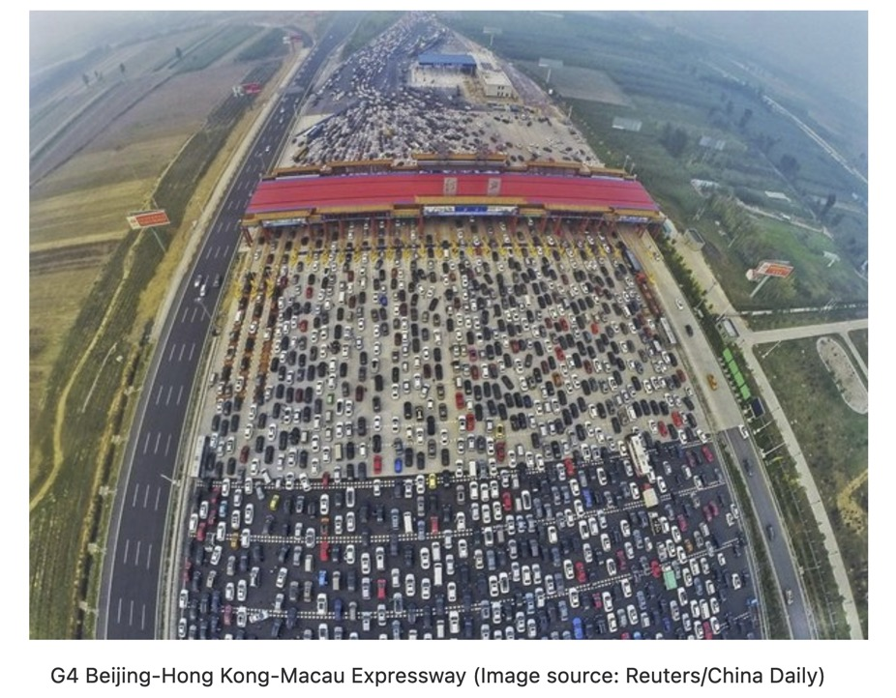
World’s Widest Highways
IH-10 in Houston TX
what happens to width when speeds are lower?

Slide 10
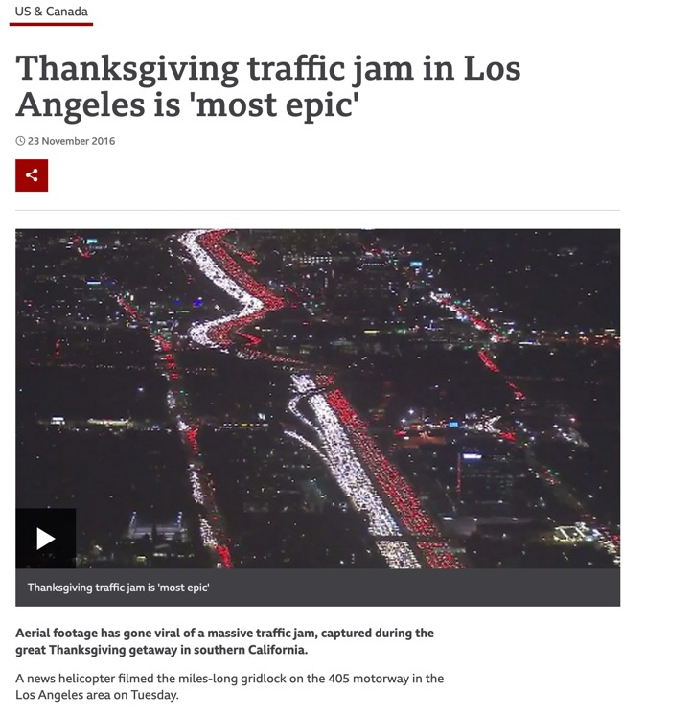
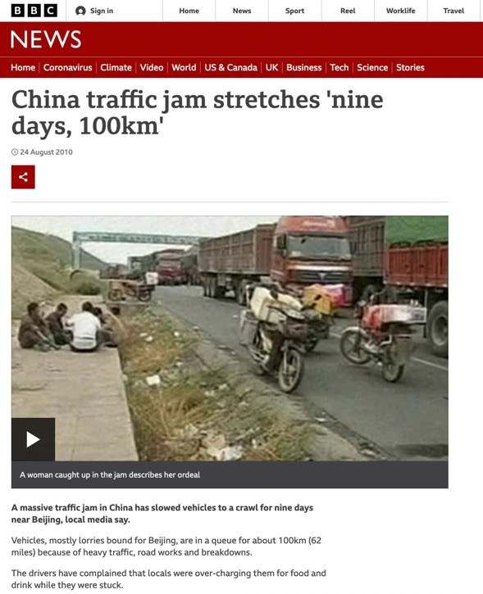
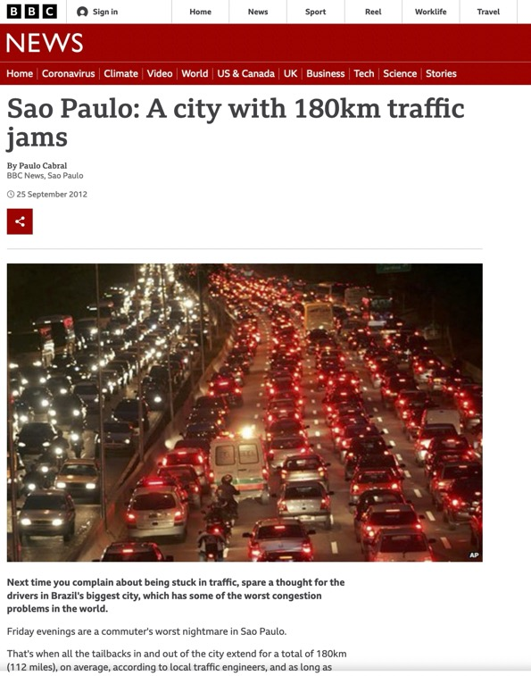
World’s Worst Traffic Jams
mostly in large developing cities

Slide 11
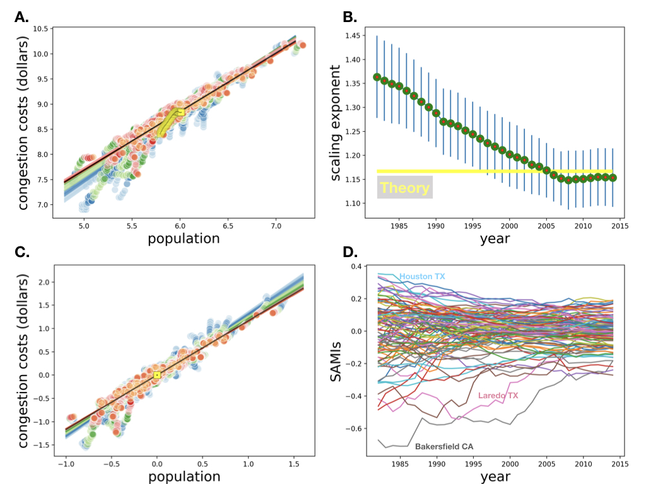
different colors are different years
different colors are different years
https://royalsocietypublishing.org/doi/pdf/10.1098/rsif.2019.0846
Notes:
Congestion (these are estimated extra costs of congestion) are superlinear and a fixed fraction of GDP as predicted.

Slide 12
building heights
$$GDP/A_{n}∼N^{2δ}$$
Land rents increase faster than incomes
building heights
$$∼N^{δ}$$
larger cities get rising skylines

Slide 13
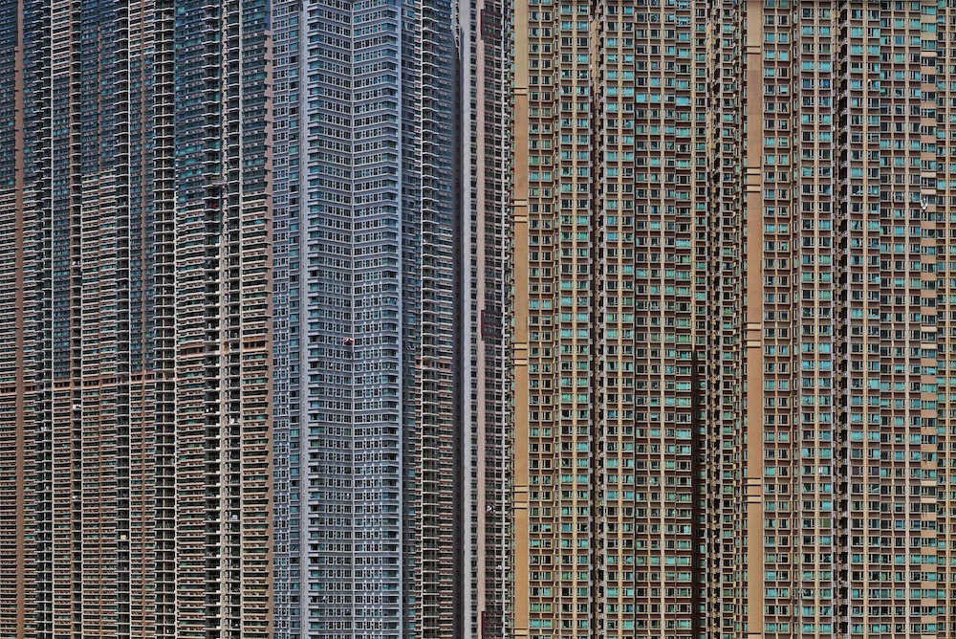
why?
Hong Kong
credit:Guardian

Slide 14
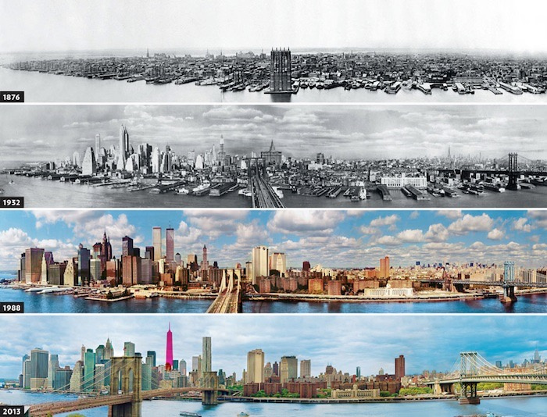
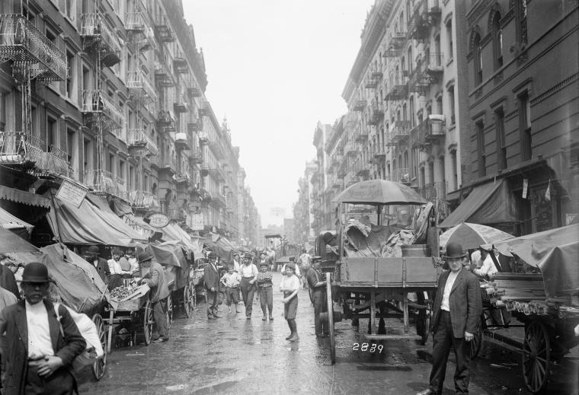

Slide 15
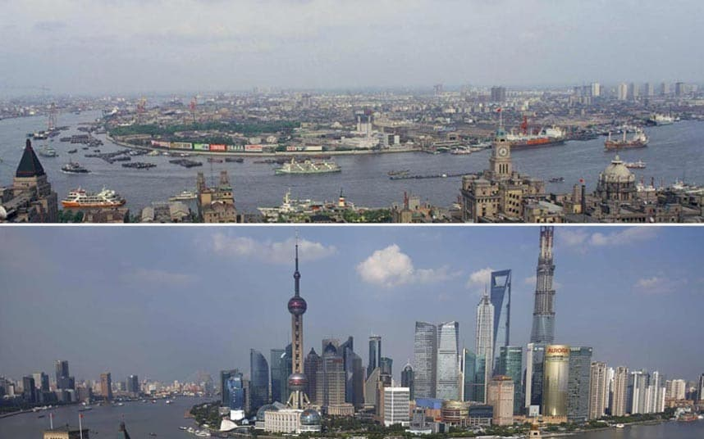
credit: telegraph

Slide 16
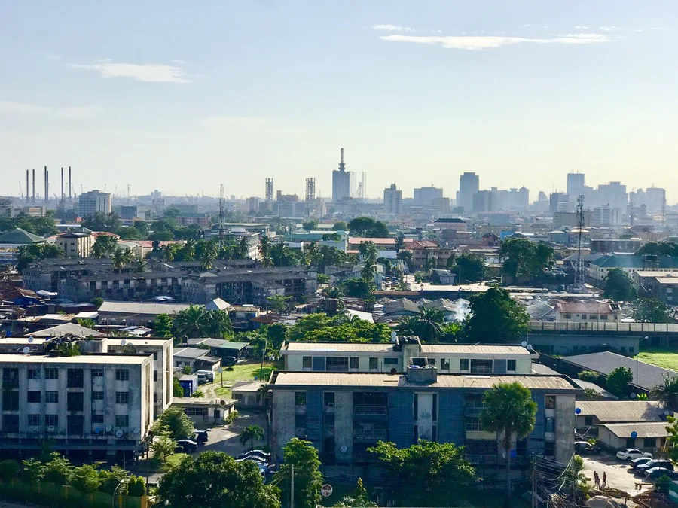
credit: Obinna Okerekeocha
Notes:
Buildings get bigger and taller in larger cities: is this predictable?

Slide 17
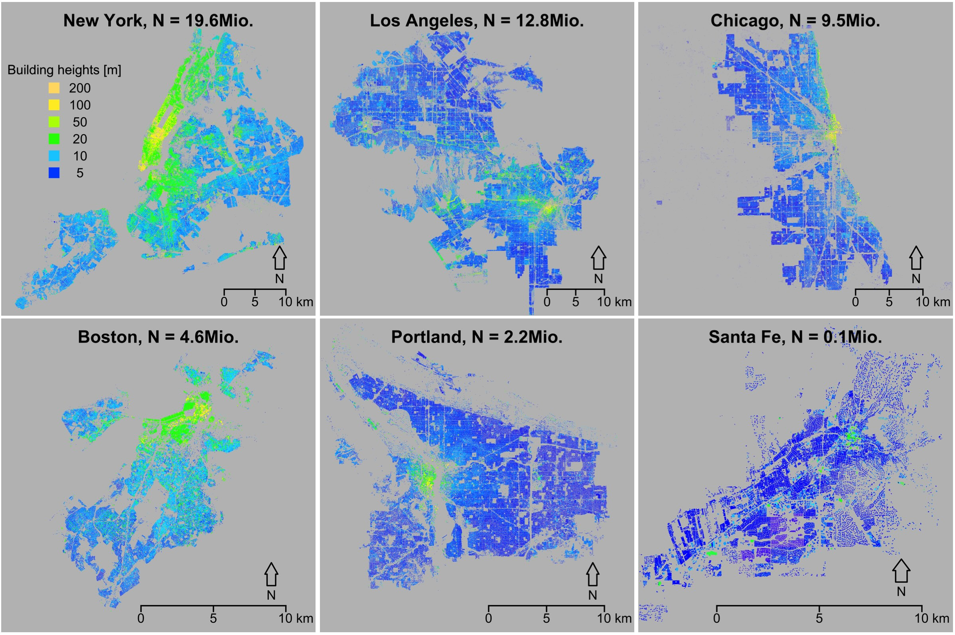
data from LiDAR
Schlaepfer, Lee, Bettencourt (2016)
Urban Skylines: building heights and shapes as measures of city size

Slide 18
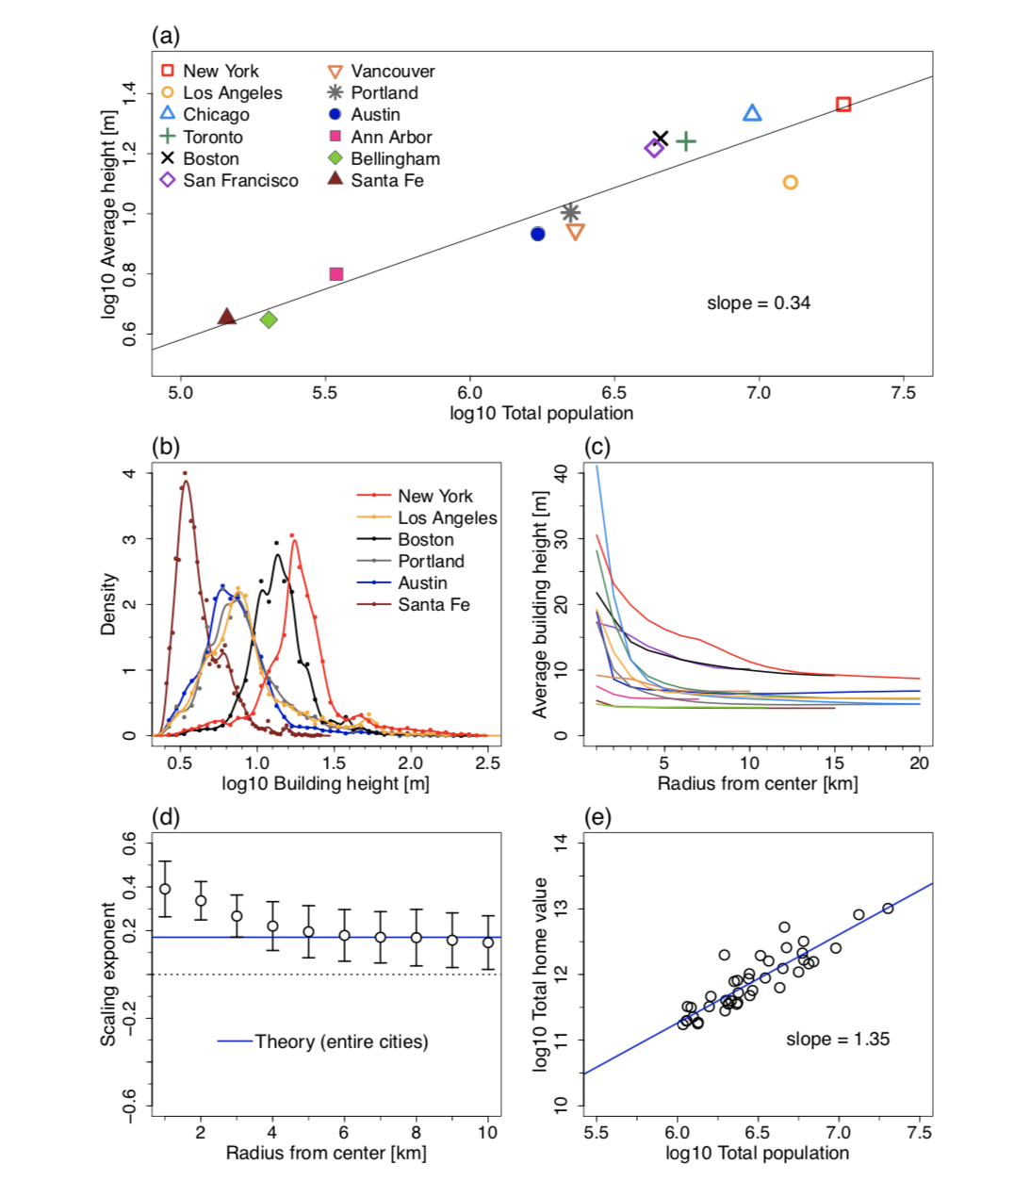
A.
B.
C.
D.
E.

Slide 19
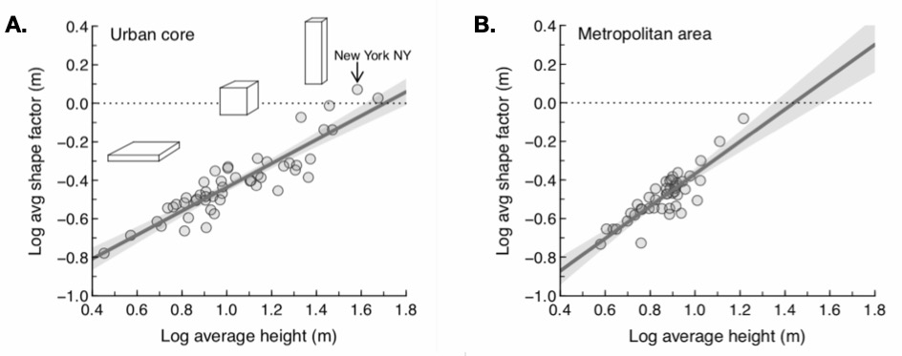

Slide 20
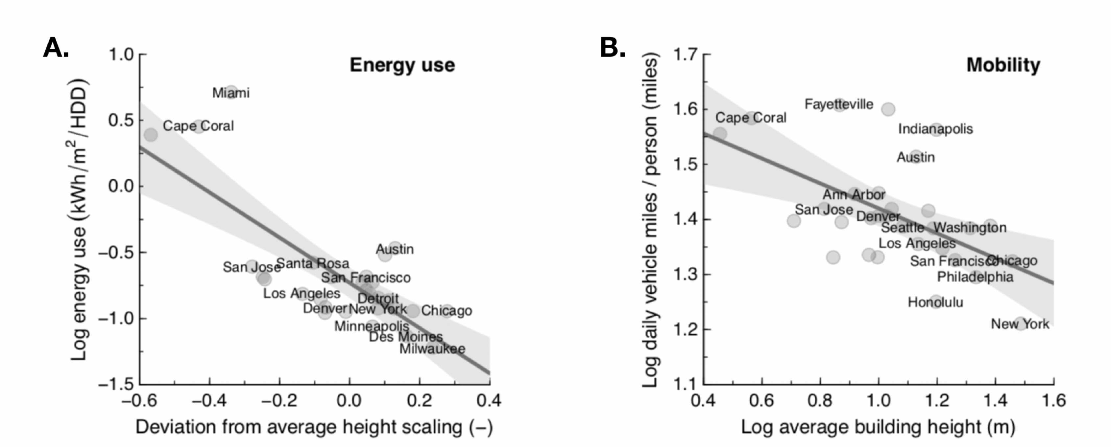
Higher buildings lead to savings in energy use and mobility

Slide 21
Social Networks get denser
average connectivity per capita:
$$∼N^{δ}$$

Slide 22
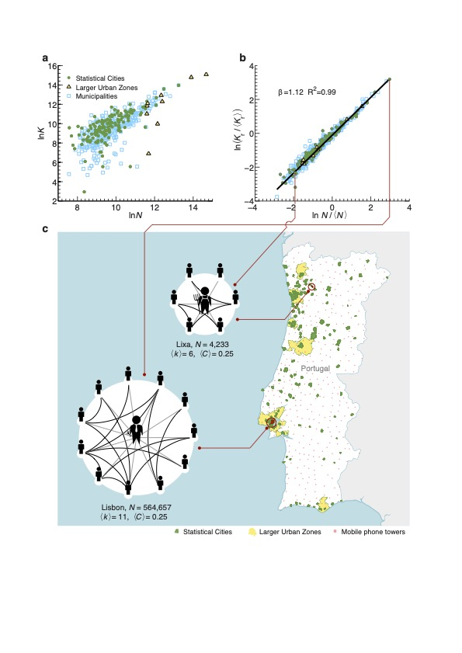
Urban cellphone networks
𝛽 = 1.12-1.19
in agreement with theory.
Network clustering
is preserved:
same sense of
community
in town and country!
Schläpfer et al, 2014
Notes:
Urban social networks from cell phones scale as expected

Slide 23
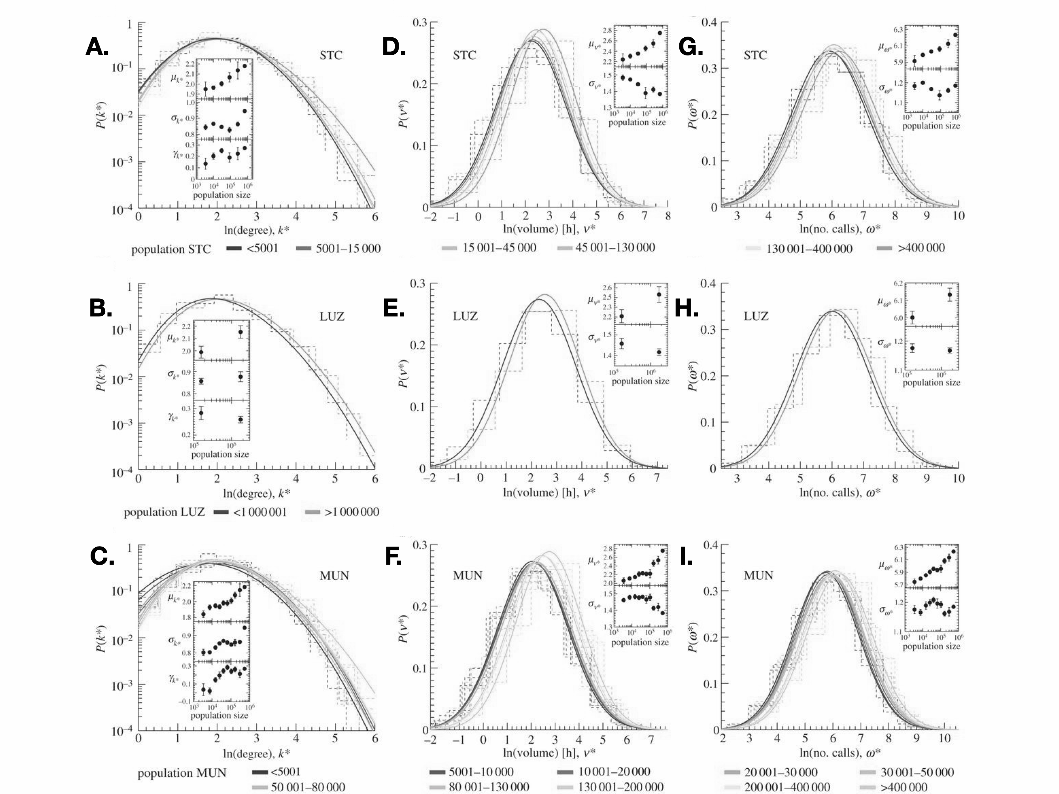
10 connections
From cellphones” distribution of degree is very wide (lognormal)
500 connections
Notes:
But we can also observe their statistics (which is approximately lognormal)

Slide 24
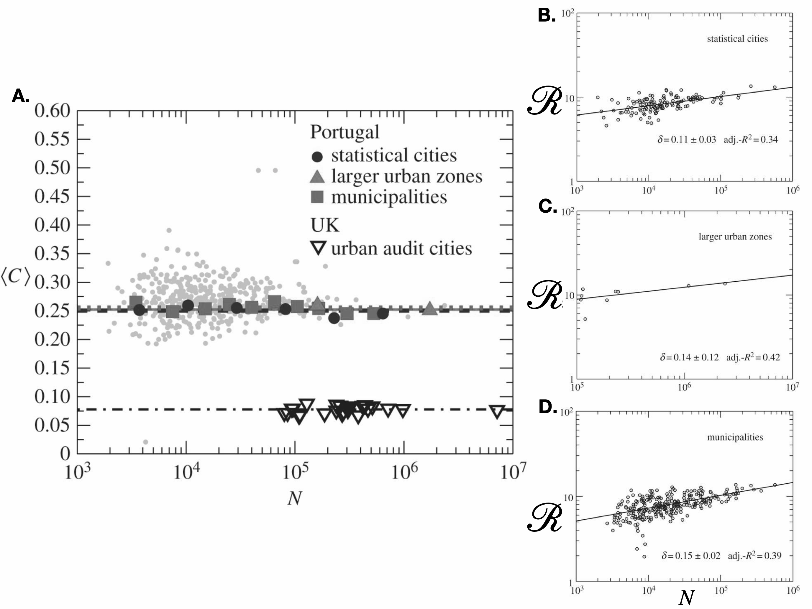
How many of your friends are mutual friends ?
clustering coefficient
Contagion Dynamics
scales superlinearly
with population size
https://royalsocietypublishing.org/doi/full/10.1098/rsif.2013.0789
Notes:
Contagion (and the reproductive number of infectious diseases) also scale superlinearly (see book for calculation).

Slide 25
Contagious Diseases and Information spread faster in larger cities
average connectivity per capita:
$$k(N)∼N^{δ}$$

Slide 26
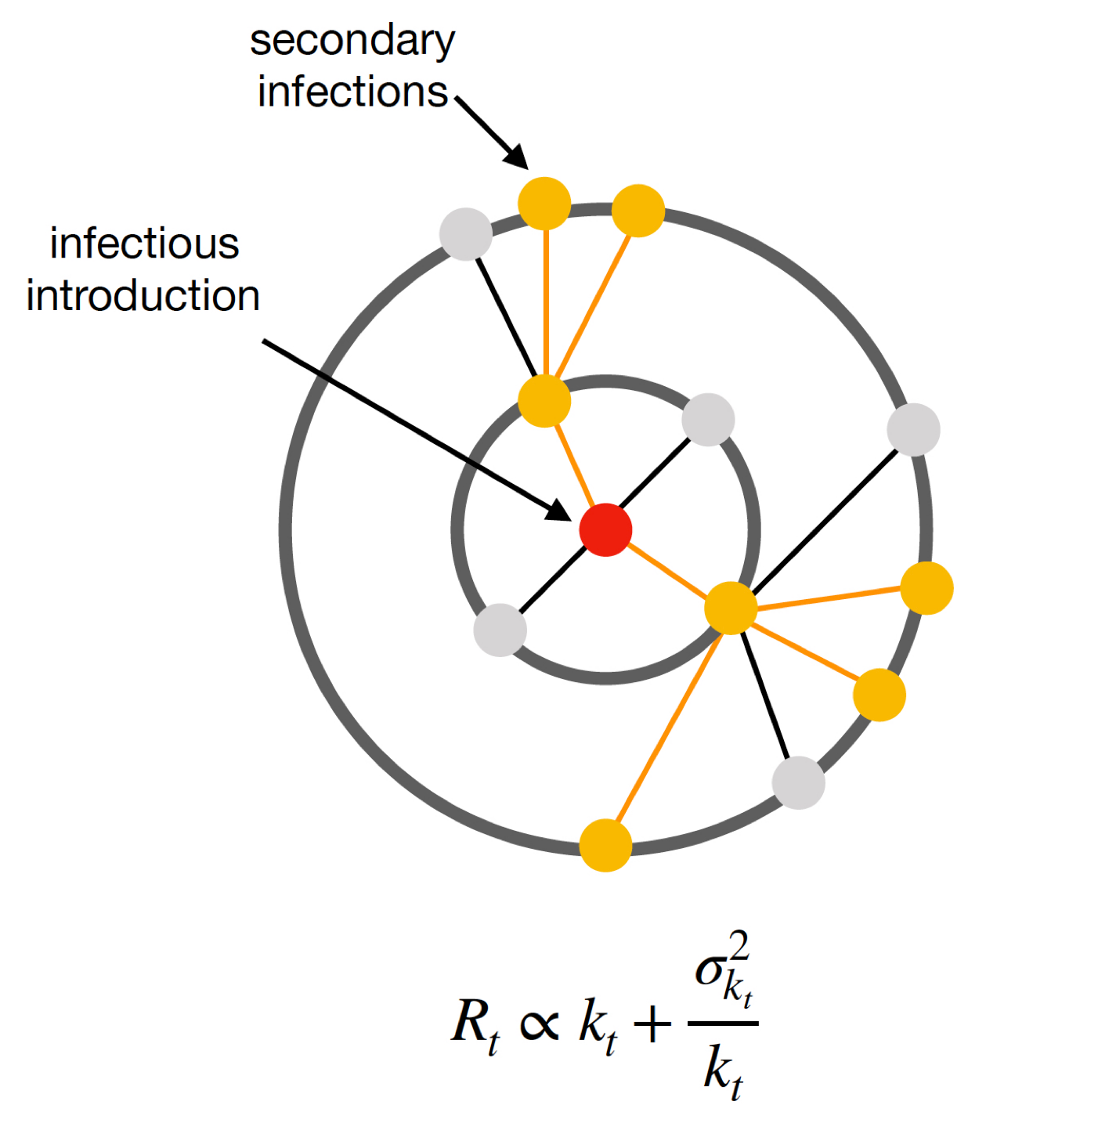
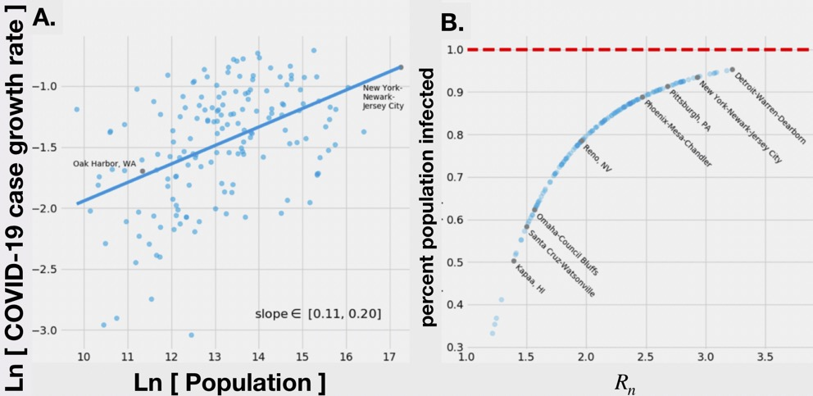
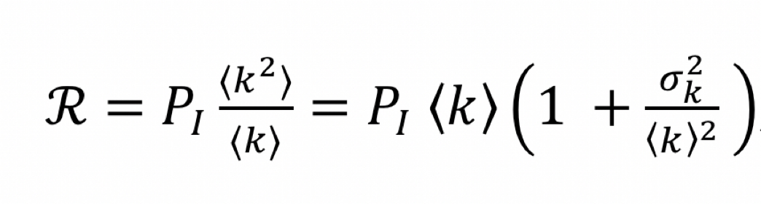
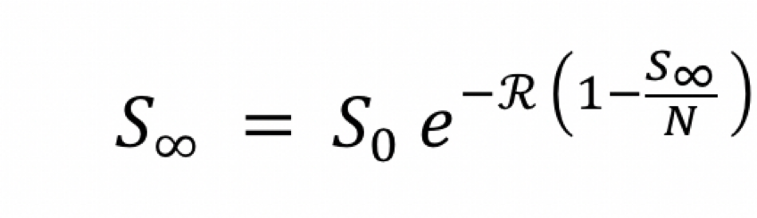
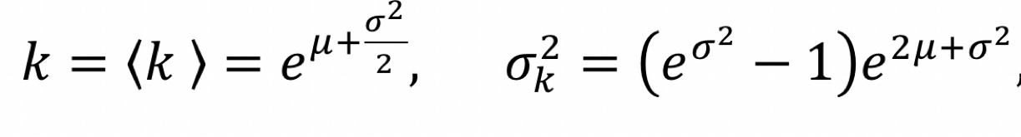
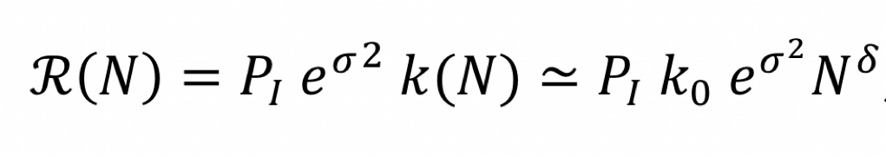
https://www.nature.com/articles/s42949-021-00030-0
Contagious Processes on Networks
For COVID-19:
Reproductive number:
size of the outbreak
vaccination rate:
$$P_{v}=1-1/R$$

Slide 27
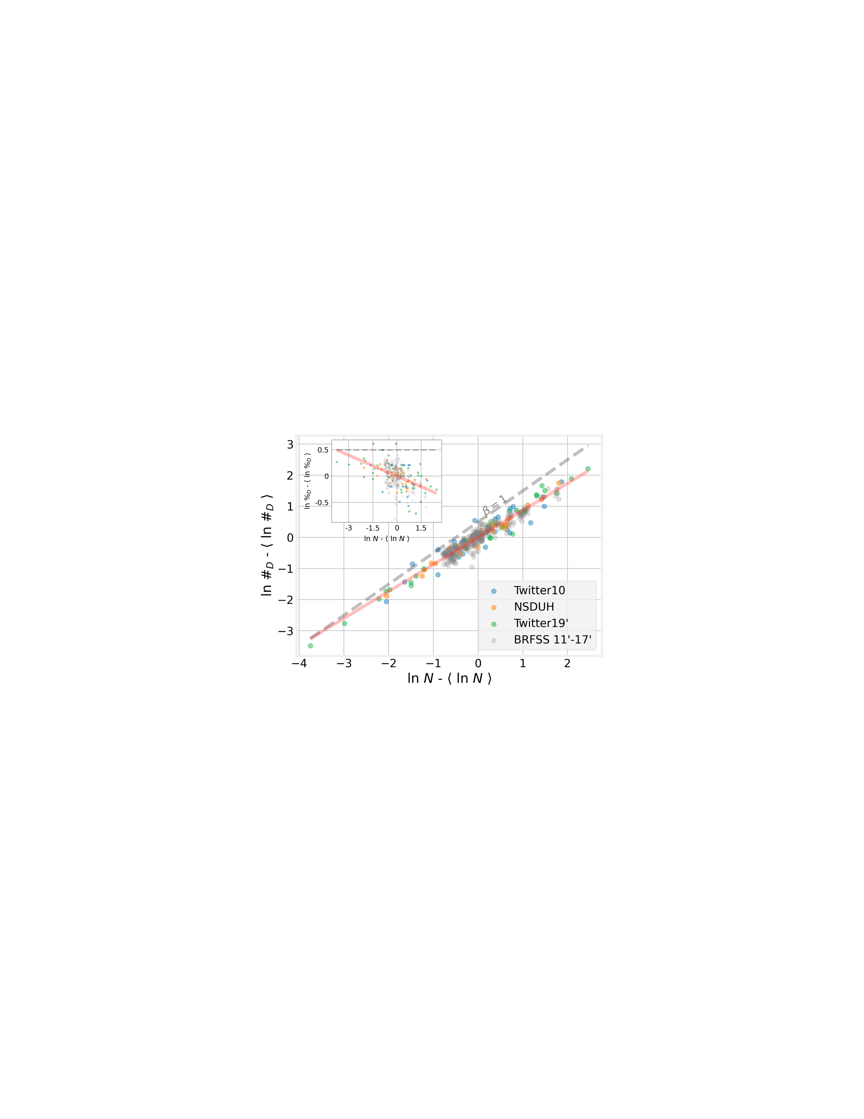
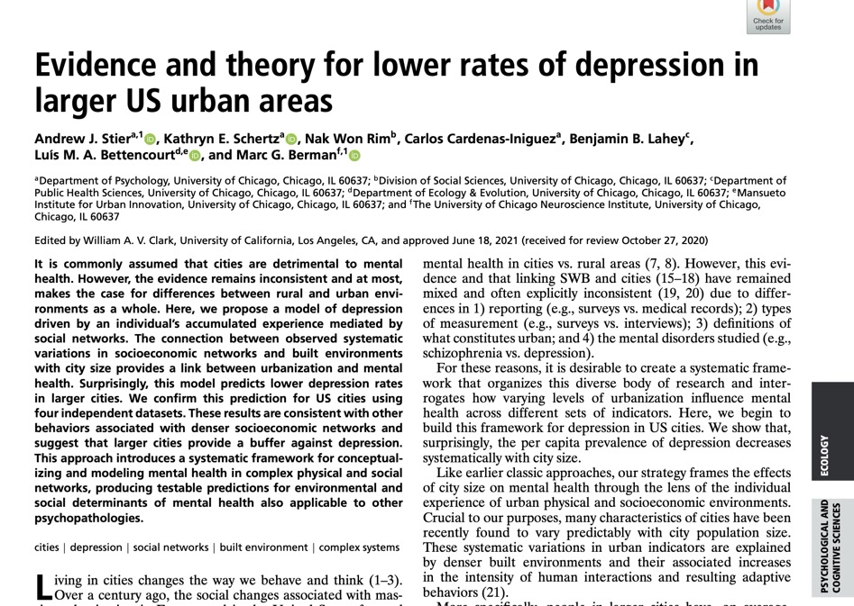
Mental Health
https://www.pnas.org/doi/10.1073/pnas.2022472118
Notes:
Depression is lower for people with more social contacts, it follows it should be lower in larger cities, as observed.

Slide 28
The pace of life accelerates
average rates of production and exchange per capita:
$$y(N)∼N^{δ}$$
speeds
$$[y]∼1/time$$
times between events “shrink” : $∼N^{-δ}$
quantifies some measures of overload

Slide 29
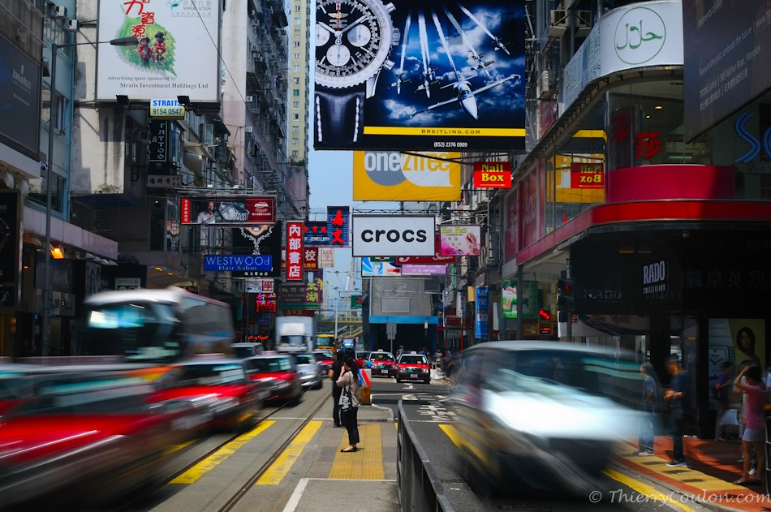
Notes:
Larger cities feel faster…

Slide 30
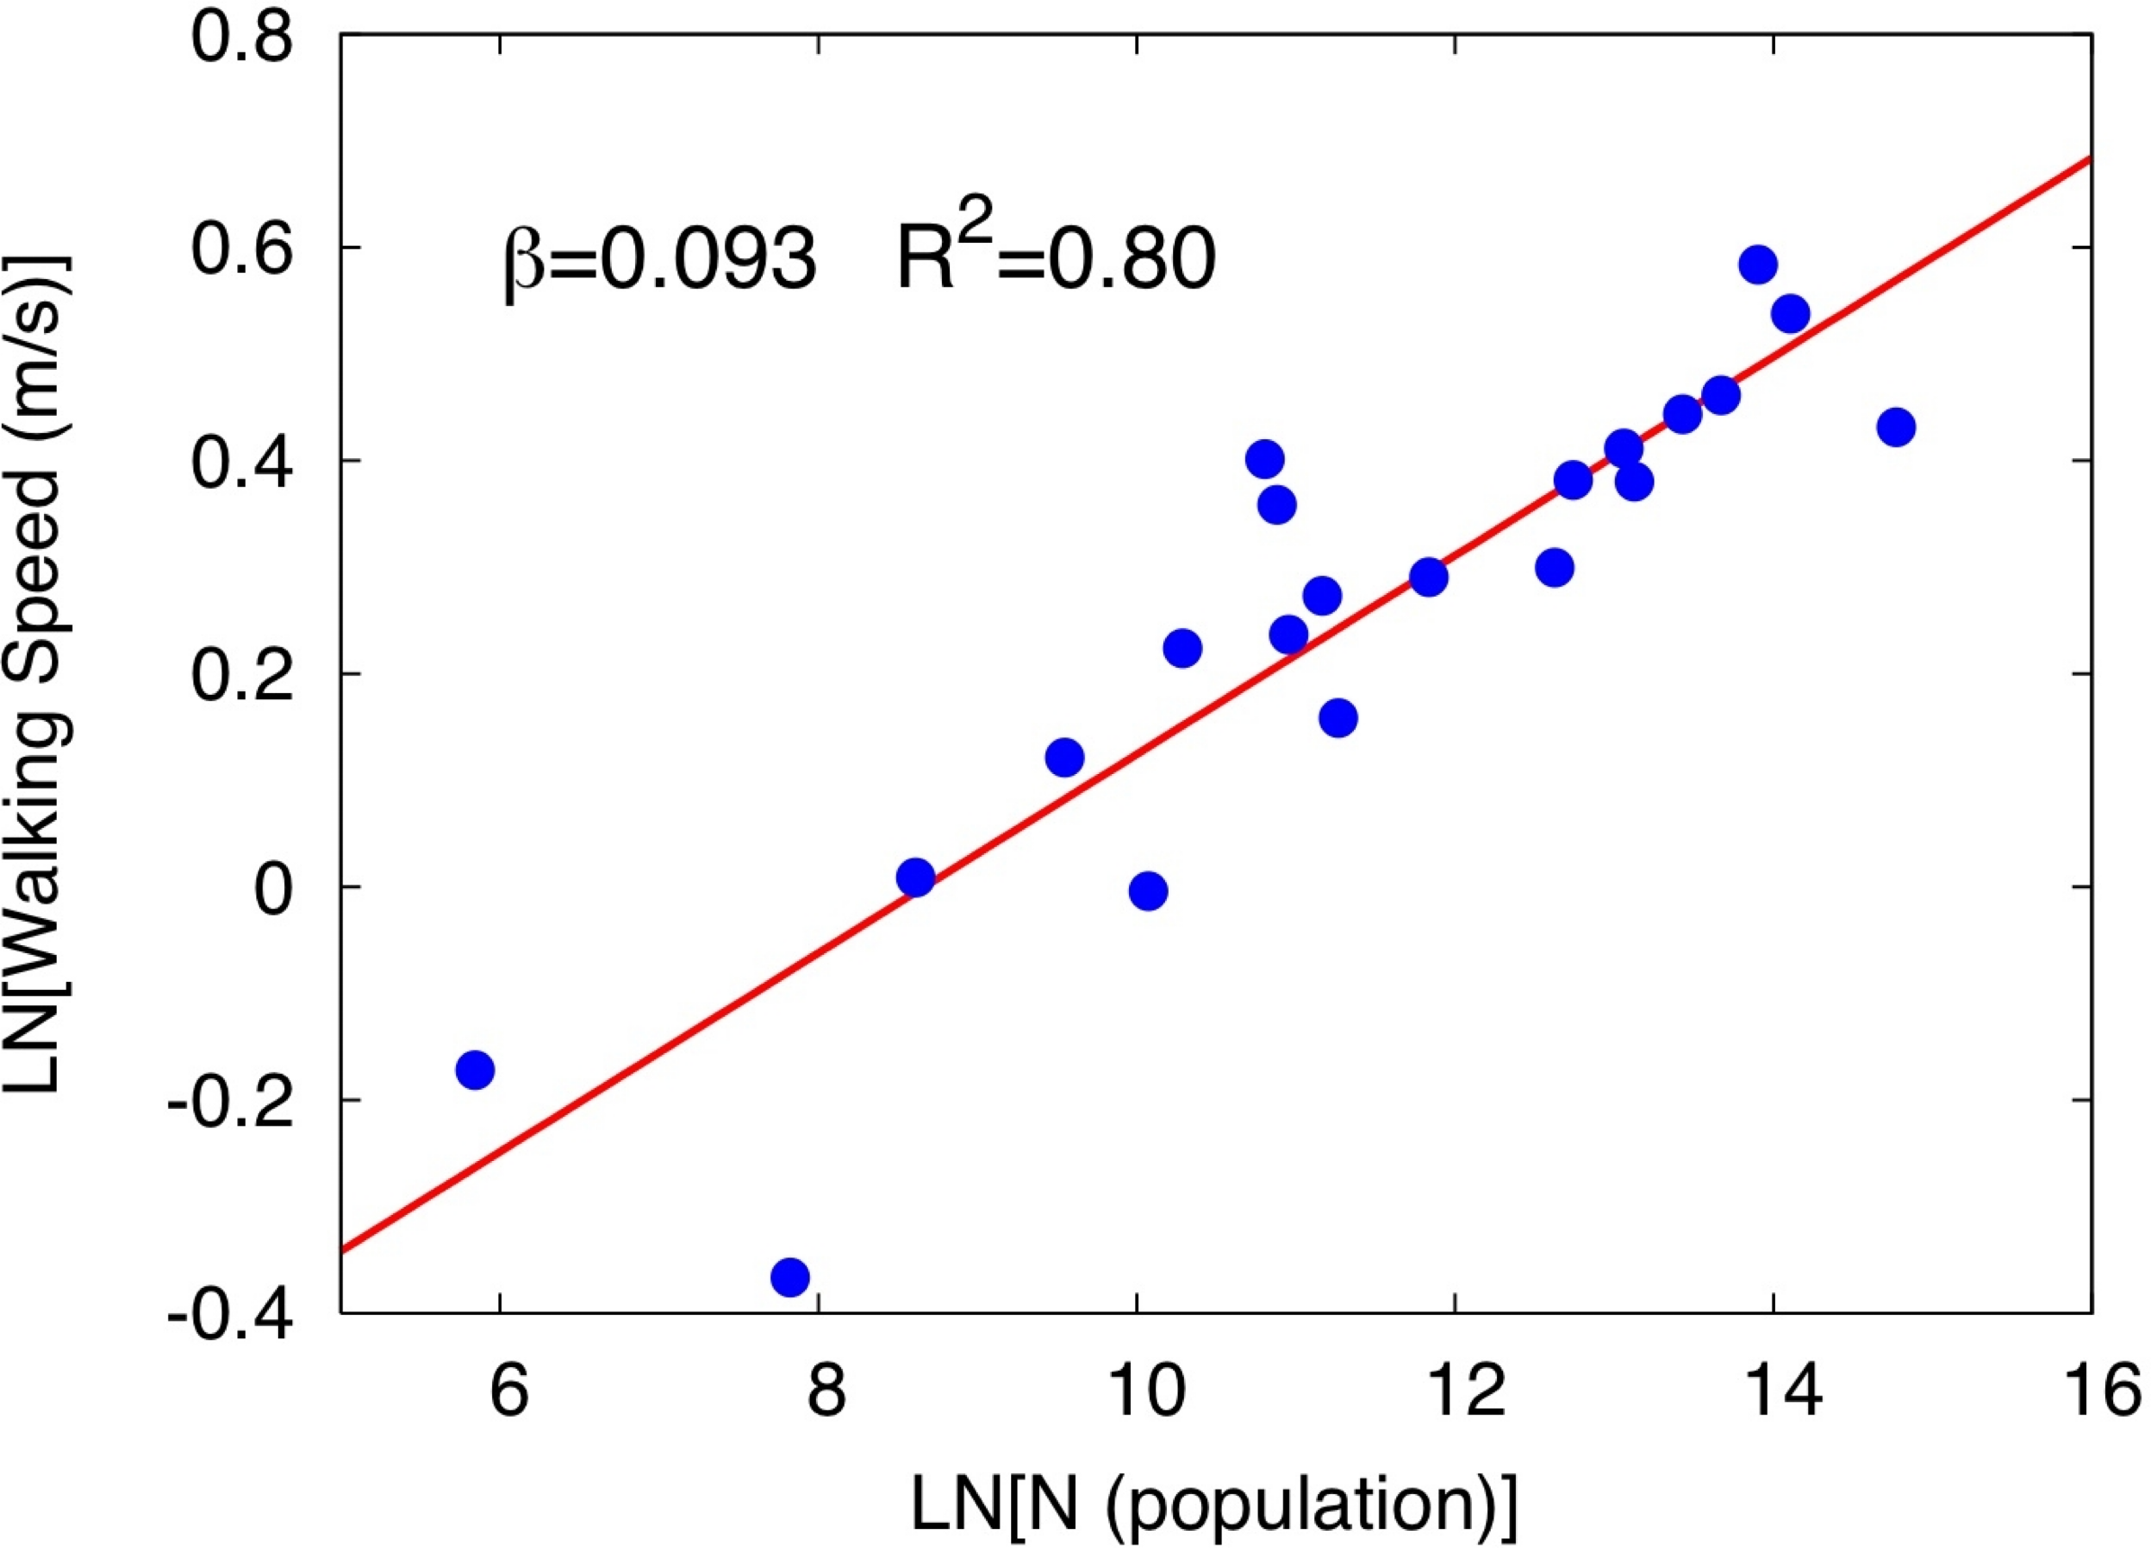
Walking Speed vs Population Size
$$y=Y_{0}N^{δ}∼mv^{2}$$
$$v∼N^{δ/2}=N^{1/{12}}$$
Notes:
People walk faster…

Slide 31
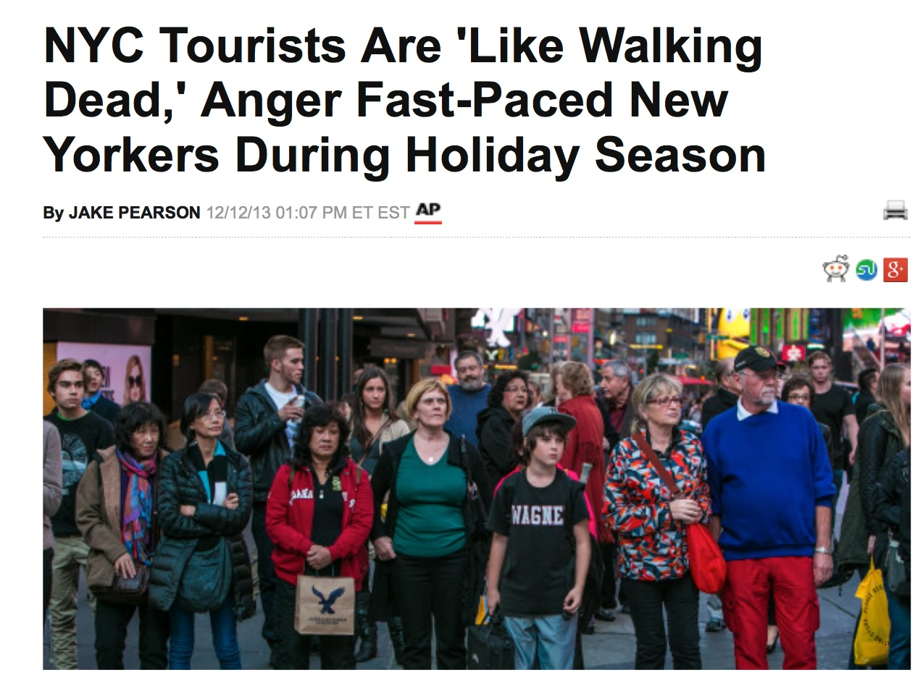
"They're like the walking dead, real slow," griped Dennis Moran, 46, a fire safety officer at a building in Times Square and a native New Yorker. "They have this unnatural habit of stopping in the middle of the sidewalk."
credit: Huffington Post
Notes:
Visiting people (tourists) to larger cities are just too slow. It would be an interesting experiment to see if such people adapt and sped up over time, as they spend time in larger cities. How long does that take?

Slide 32
Fractal Dimension of
Built Spaces

Slide 33
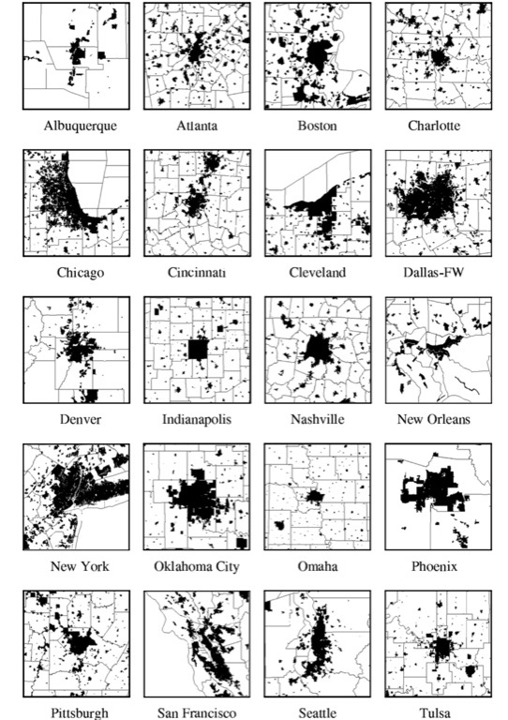
Shapes of built spaces of cities
1990s
Fractal Dimension
$$D_{f}=\frac{log\frac{M(R)}{M_{0}}}{log\frac{R}{R_{m}}}$$
$$M(R)=M_{0}R^{D_{f}}$$
Use it for built area and population
$${D_{f}}^{N}=\frac{log\frac{N}{N_{0}}}{log\frac{R}{R_{m}}}$$
$${D_{f}}^{A_{n}}=\frac{log\frac{A_{n}}{A_{0}}}{log\frac{R}{R_{m}}}$$
$$\frac{{D_{f}}^{A_{n}}}{{D_{f}}^{N}}=\frac{logA_{n}-logA_{0}}{logN-logN_{0}}=\frac{ΔlogA_{n}}{ΔlogN}=\frac{5}{6}$$
another way to measure urban scaling exponents
Notes:
Fractal dimensions of built spaces have been interesting to geographers and complex systems researchers for decades: Scaling predicts that the ratio of fractal dimensions is a scaling exponent, specifically the ratio of the fractal dimension of built up area to population is 5/6 because it is in fact the derivative of the former scaling law vs population.

Slide 34
Slums and Informal Settlements
Have incomplete infrastructure networks, can use these ideas to identify where and how much to do

Slide 35
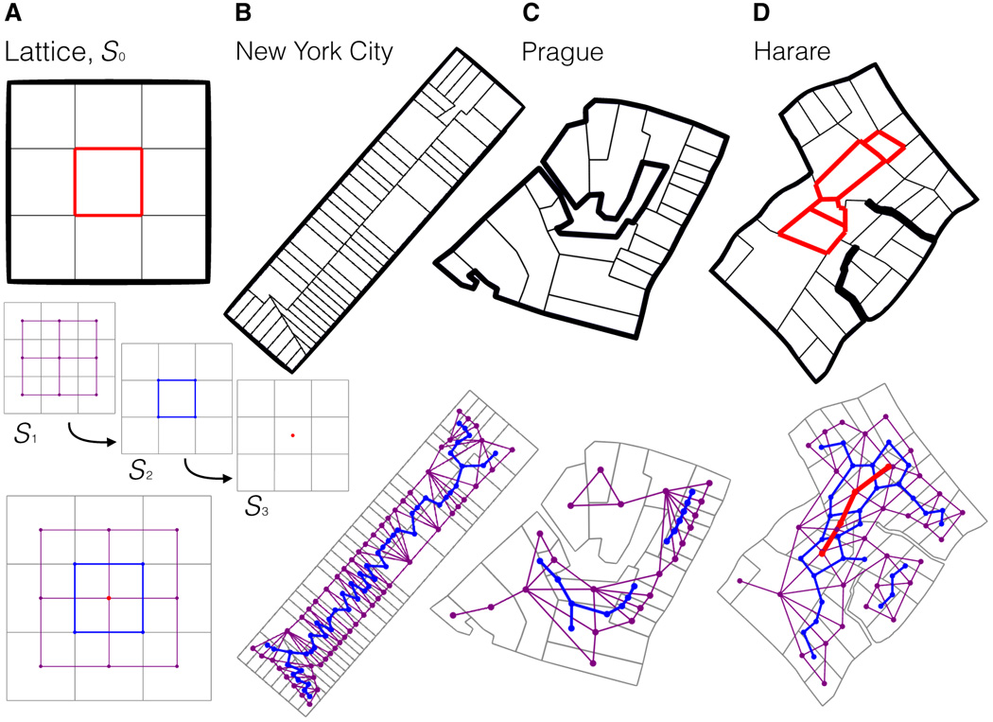
A network (graph theory) model to identify disconnected parcels and underserviced city blocks
https://www.science.org/doi/10.1126/sciadv.aar4644
Notes:
Slums are places (among other things) where the networks of the city (infrastructural and socioeconomic) have not yet formed, but are only latent. We can measure the lack of infrastructure to buildings using topological methods.

Slide 36
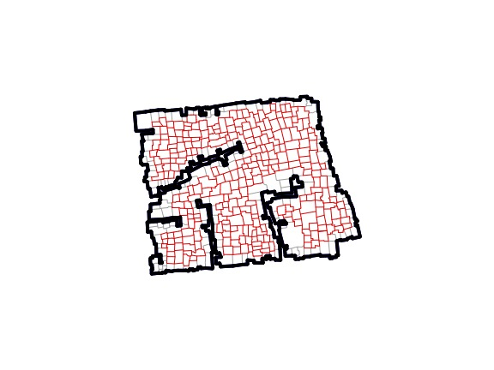
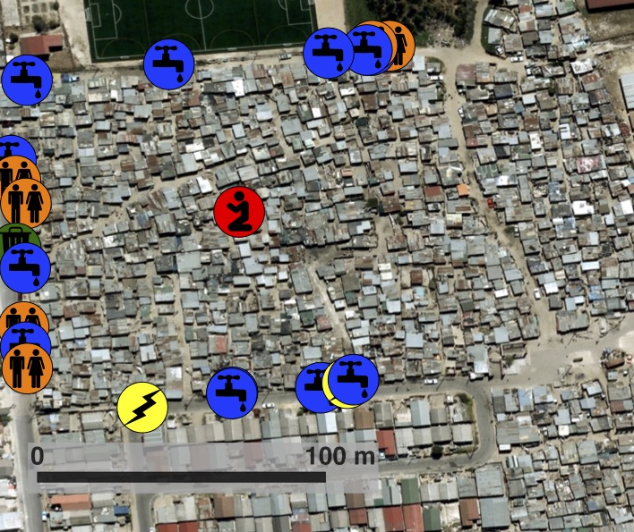
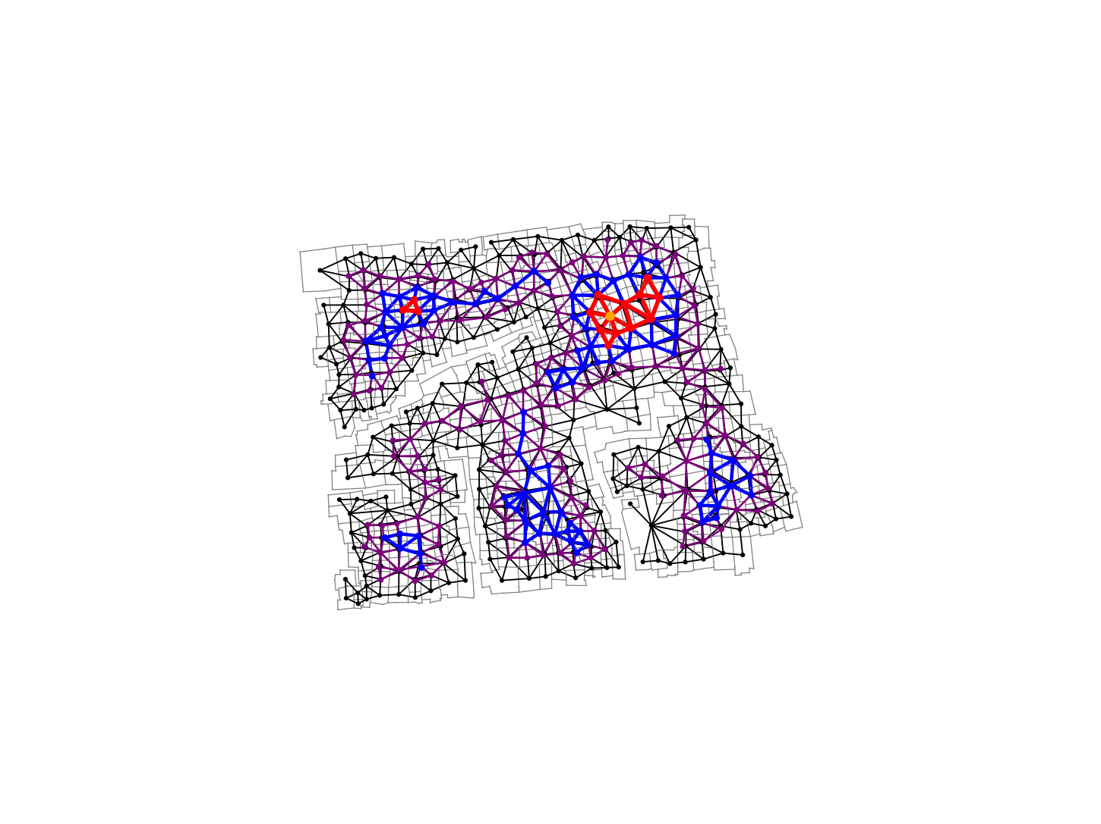
A disconnected block in a South African Township

Slide 37
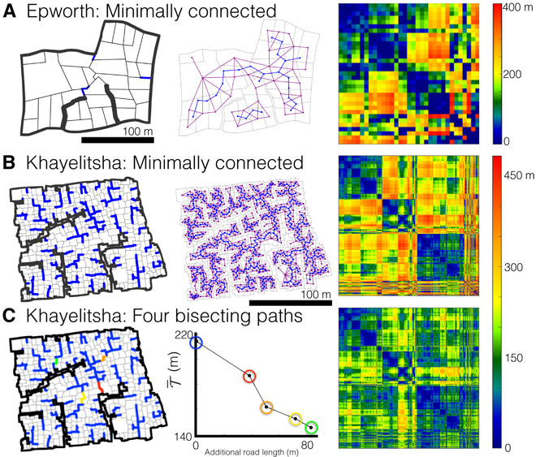
Notes:
Connectivity can be expanded to connect each building…

Slide 38
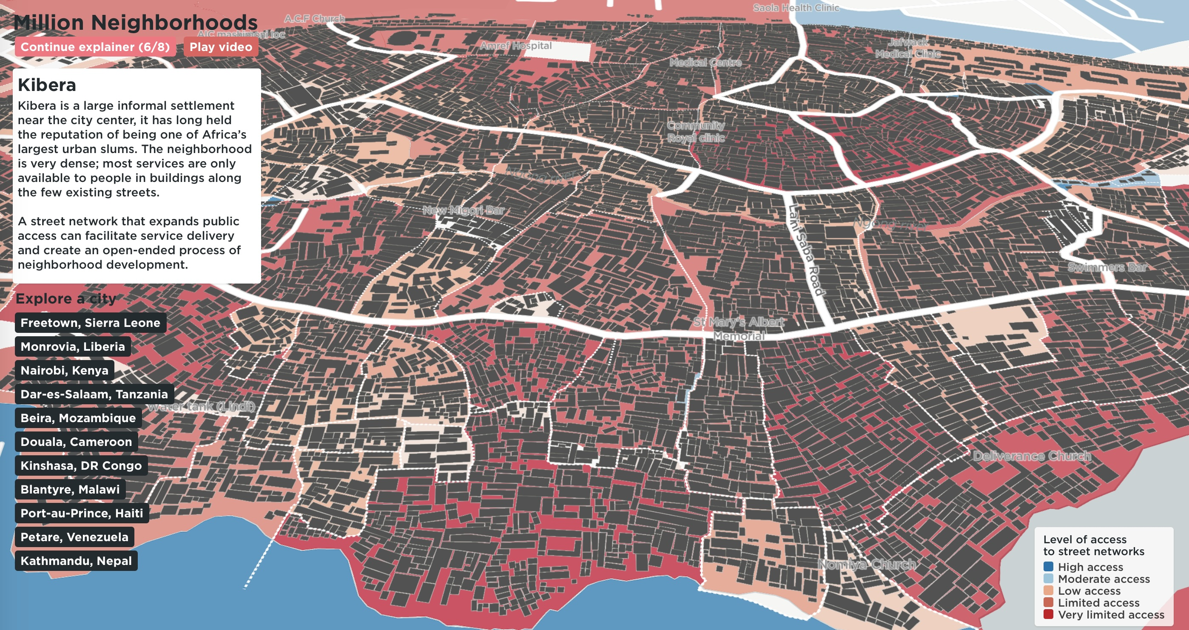

Slide 39
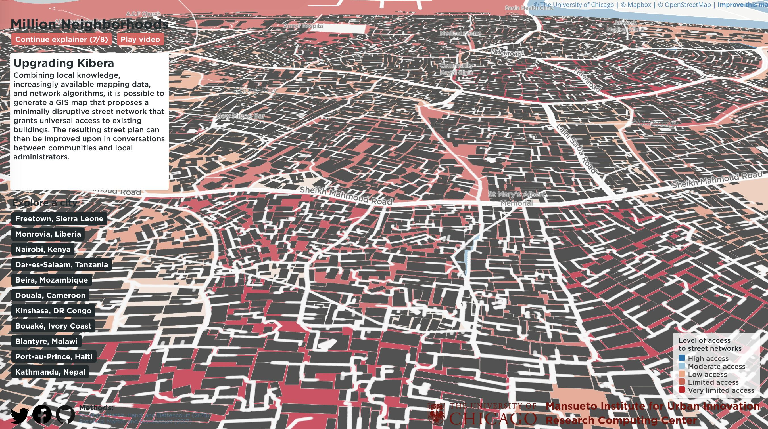
https://millionneighborhoods.org
About 150 km of new accesses are needed in Kibera.
Notes:
And estimate the (minimal) length of extra infrastructure to be built…

Slide 40
A large number of interconnected phenomena
From behavior and cognition
To infrastructure
To socioeconomic performance
Can be understood and predicted by a theory of cities as complex networks
This kind of theory will allow us to predict characteristics of cities throughout history and across diverse contexts
What about exceptions? Inequality? Growth? Information?

